Slide 1
How do we know what the interior of Earth is like if we have never "been there"?
By: Group 1

Slide 2
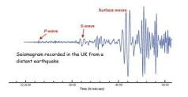
What are seismic waves?
shock waves generated by earthquakes and explosions that travel through Earth and across its surface
Our answer: seismic waves
How can we see the seismic waves?
An instrument called a Seismograph or seismometer can be used to record the motion of the ground. Ex;
How can it travel through the layers of the earth?
changes in composition, pressure, and temperature within the layers of the Earth.
How can we use the waves when there aren’t always huge earthquakes?
Seismic waves are very sensitive. Even when there isn’t a big earthquake there are always smaller ones every day.

