Slide 1
How do we know what is inside the earth if we've never been there?
Group 2

Slide 2
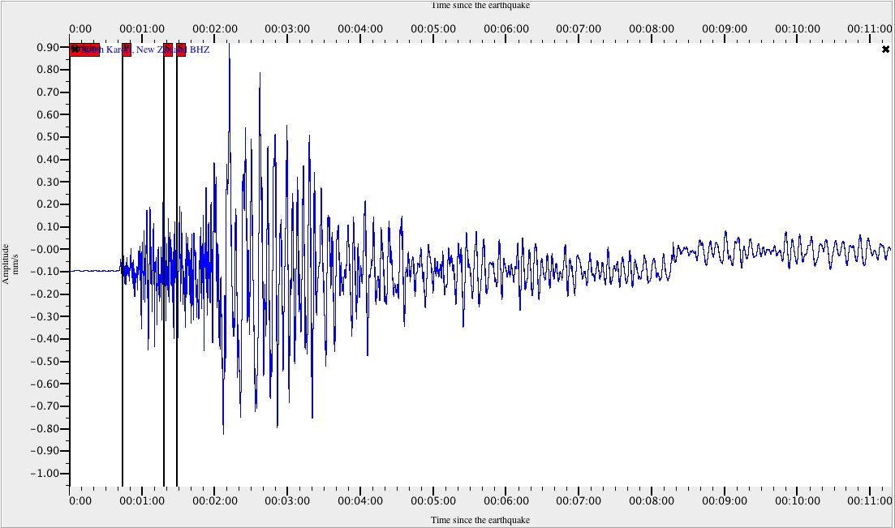
Seismic waves
Seismic waves helped geoscientists identify the structure of the core itself. In the late 19th century, scientists noted a “shadow zone” deep in the Earth, where a type of body wave called an s-wave either stopped entirely or was altered. S-waves are unable to transmit through fluids or gases. The sudden “shadow” where s-waves disappeared indicated that Earth had a liquid layer.
Most core research has been conducted by measuring seismic waves, the shock waves released by earthquakes at or near the surface. The velocity and frequency of seismic body waves changes with pressure, temperature, and rock composition.
Kaylee
This Photo by Unknown author is licensed under CC BY-NC-ND.

Slide 3
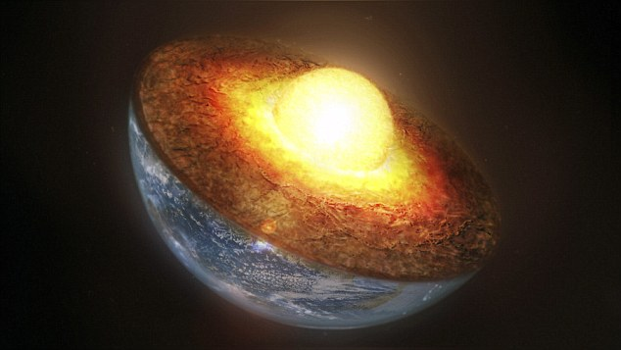
Inner core
The inner core is a hot, dense ball of (mostly) iron. It has a radius of about 758 miles. The temperature in the inner core is about 9,392° Fahrenheit. The pressure is nearly 3.6 million atmospheres (atm).
The temperature of the inner core is far above the melting point of iron. However, unlike the outer core, the inner core is not liquid or even molten. The inner core’s intense pressure—the entire rest of the planet and its atmosphere—prevents the iron from melting. The pressure and density are simply too great for the iron atoms to move into a liquid state. Because of this unusual set of circumstances, some geophysicists prefer to interpret the inner core not as a solid, but as a plasma behaving as a solid.
Jai
This Photo by Unknown author is licensed under CC BY-NC-ND.

Slide 4
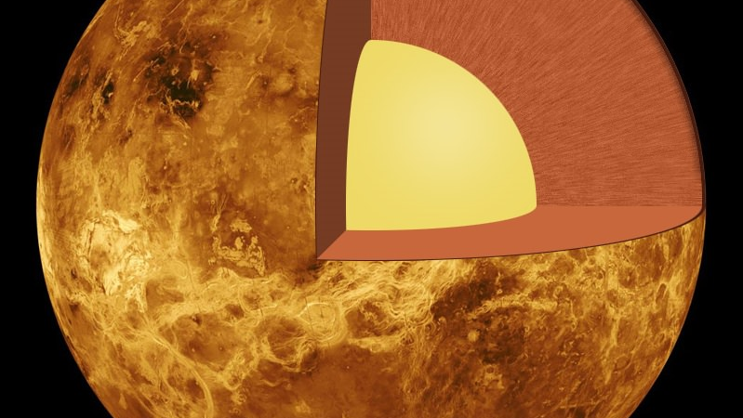
Outer Core
The outer core, about 1,367 miles thick, is mostly composed of liquid iron and nickel. The NiFe alloy of the outer core is very hot, between 8,132° and 9,932° Fahrenheit.
The liquid metal of the outer core has very low viscosity, meaning it is easily deformed and malleable. It is the site of violent convection. The churning metal of the outer core creates and sustains Earth’s magnetic field. The hottest part of the core is the Bullen discontinuity, where temperatures reach 10,800° Fahrenheit—as hot as the surface of the sun.
Justin
This Photo by Unknown author is licensed under CC BY.

Slide 5
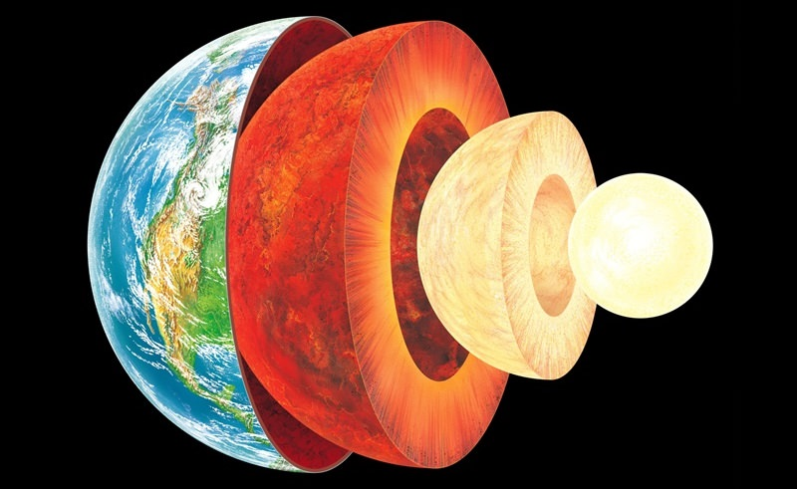
Mantle
The majority of the interior of the Earth is made up of the mantle. The Earth's thin exterior layer, the crust, and it's located near the extremely hot core and it's separated by the mantle from the earth.
It accounts for approximately 85% of the weight of the Earth. The mantle is made up of magma, which is a semi-molten rock.
Justin
This Photo by Unknown author is licensed under CC BY.

Slide 6
Work Cited
https://education.nationalgeographic.org/resource/core
https://www.twinkl.com/teaching-wiki/mantle
https://education.nationalgeographic.org/resource/mantle

