Slide 1
How do we know what’s inside Earth if we haven’t been there?
Group 3

Slide 2
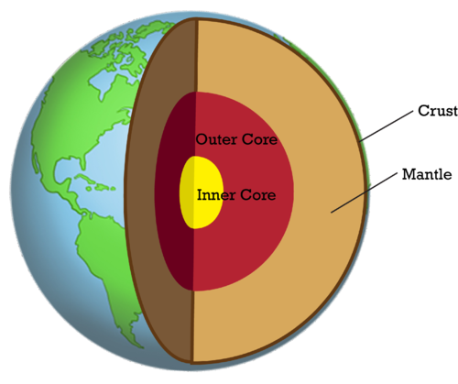
Crust
The Earth’s crust is its lightest, most buoyant rock layer. Continental crust covers 41% of the Earth’s surface, though a quarter of that area is under the oceans. The continental crust is 20 to 80 kilometers thick. Its rocks hold four billion years of Earth history

Slide 3
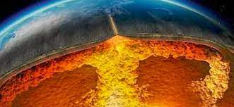
Mantle
The mantle is the thick layer of hot, solid rock between the earth's crust and the molten iron core.
It makes up the bulk of the Earth, accounting for two-thirds of the planet's mass.
The mantle is located almost 19 miles below the earth's surface and is1,800 miles thick.
It is made mostly of perovskite and post-perovskite, with smaller layers of olivine and spinel above that.

Slide 4
Outer core
The outer core of the Earth is made mostly of liquid iron and nickel alloy.
It is very massive but can barely compare to the size of the mantle.
The outer core is very important to the Earth’s magnetic field. As the liquid moves and churns, so too does the magnetic field.

Slide 5
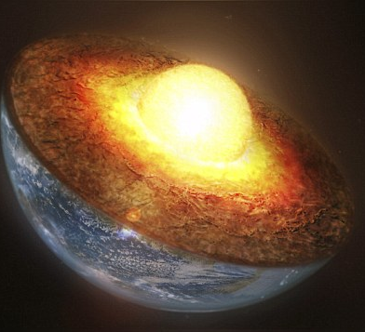
Inner core
The inner core of the earth is made of solid, dense materials.
It is also made mostly of an iron and nickel alloy.
It has a radius of 1,220 km, about 70% of what the moon’s radius is.
It is almost as hot as the surface of the Sun at about 9,800 degrees Fahrenheit.

Slide 6
Seismic activity
Seismic activity can help us to figure out what happens below the crust of the Earth.
Things like earthquakes are tracked using various tools such as seismometers, used by seismologists.
Earthquakes release huge waves of sound and vibration, which can travel thousands of miles in a very short period.

Slide 7
Mining
It is very important to figure out what materials are actually available to us, but aside from that, mining can help us figure out what’s even deeper.
One major site of this was the Kola Borehole in Murmansk Oblast, Russia. This mining project led to many new discoveries about the inside of the earth.
Volcanic activity can also bring things up from deeper inside of the earth. Volcanic rocks can contain parts of the mantle, which can be further interpreted through scientists working together.

Slide 8
Outside sources
Things like meteors, other planets, and stars can tell us a lot about about the composition of our planet.
Logically, the Earth should be made up of the materials that are available within our solar system, so scientists have figured out the chemical composition of other things within the solar system and used it to help find out what’s inside our planet.

