Slide 1
How do we know what is inside Earth if we have never been there?
By: Group 4

Slide 2
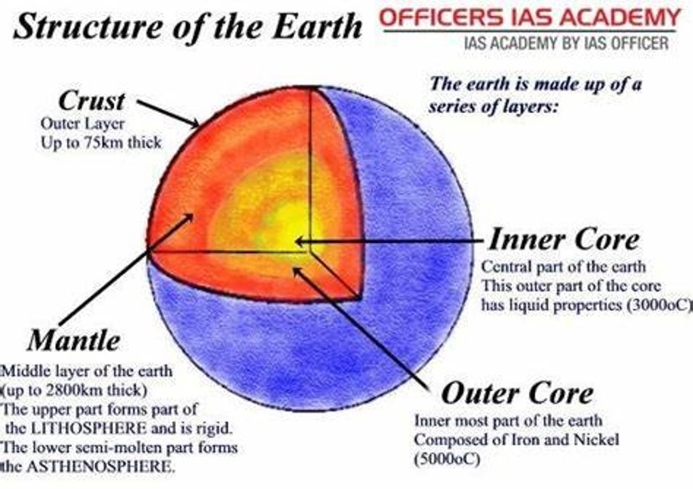
Parts of the Earth
The crust is the outermost layer of the Earth it is around 75km thick or 46 miles thick.
The mantle is 2800km or 1740 miles thick
The outer layer can get to 5000c or 9032 degrees Fahrenheit

Slide 3
Information
It is widely accepted that the Earth’s interior is composed of several layers: the crust, the mantle and the core.
Since the crust is readily accessible, scientists have been able to perform hands-on experiments to determine its composition; studies on the more distant mantle and core have more limited opportunities samples.
They also measure the interior by, seismic waves and gravity, as well as magnetic studies.

Slide 4
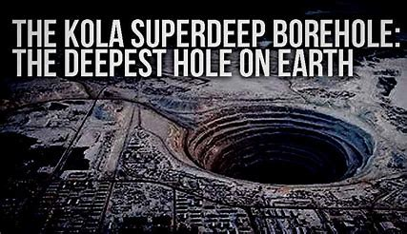
Fun fact
To this day, the deepest humankind has ever gone is just 7.6 miles below our feet — or just 0.2% of the distance to the Earth’s core.
The deepest hole ever drilled was in Kola Deep borehole in the Russian Arctic

Slide 5
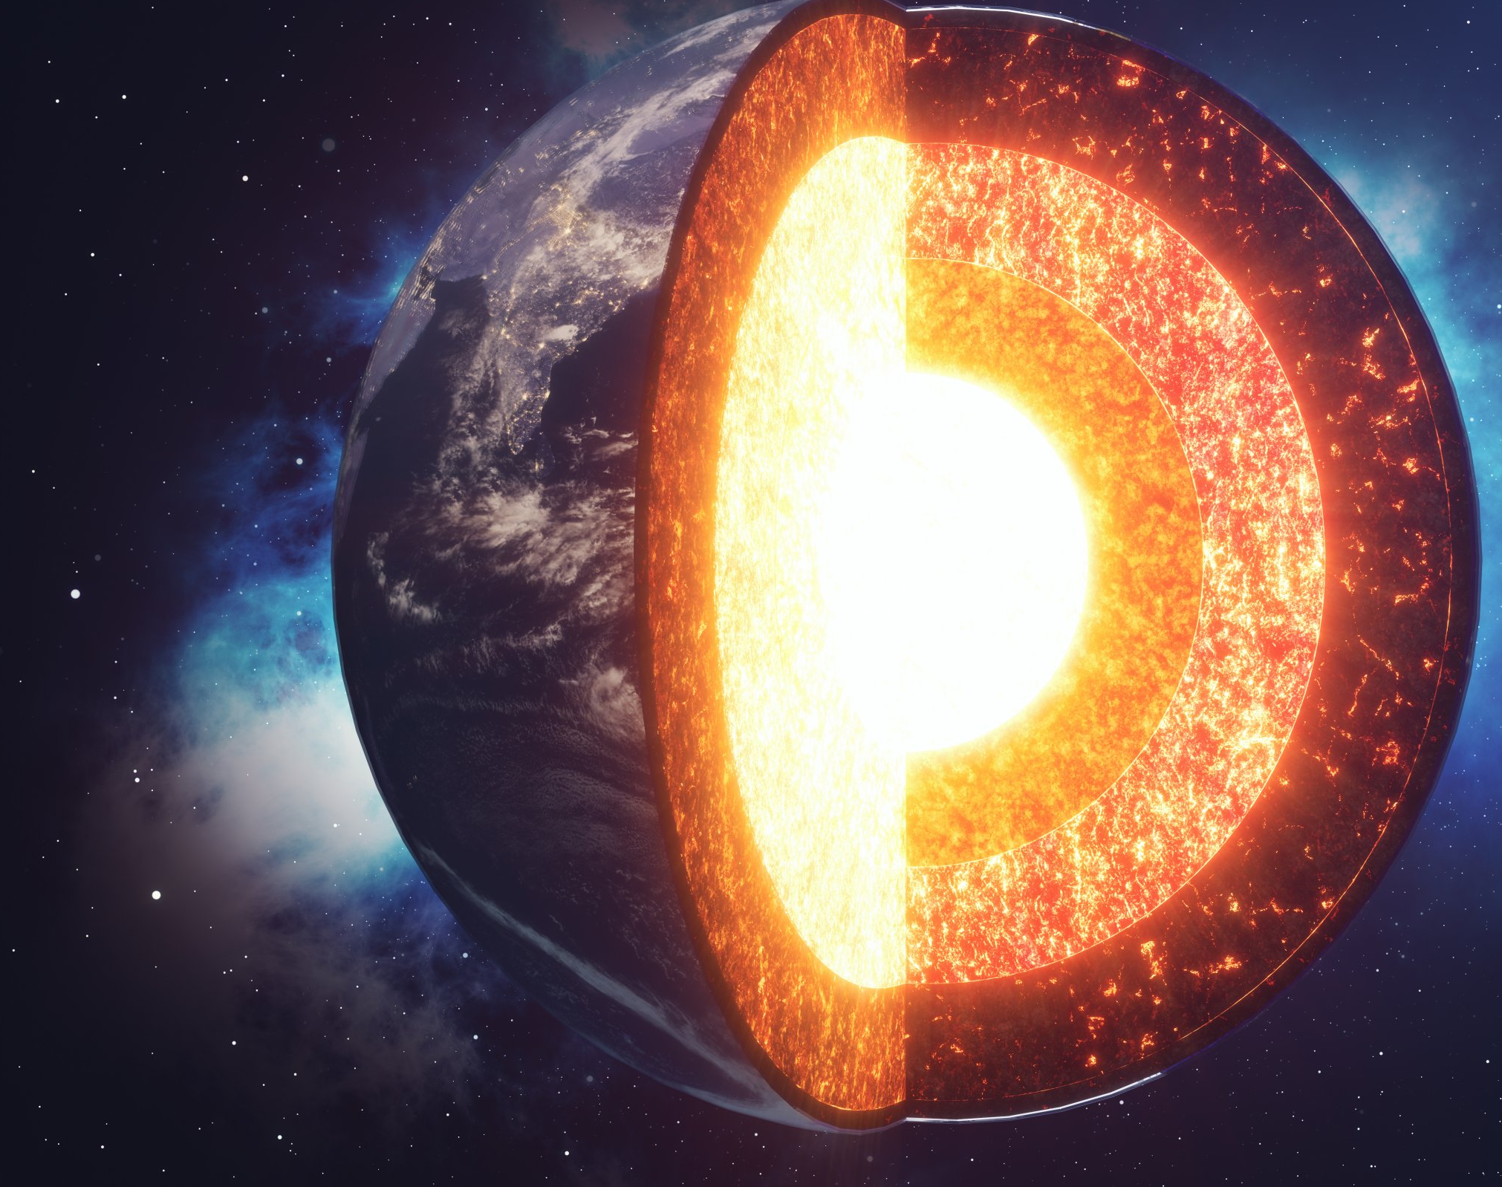
As of today, can we get to the earth's core?
Most likely not, It’s extremely hot, and it takes a lot of drilling capacity to get down there. It’s approx. 6000 C down there, and it’s approx. 6500km below us. It gets tougher and tougher to drill down.
So, in conclusion there is not 100 percent way to know what is inside the earth but using different methods we can get a good understanding.

